Slide 1
British Airways
Predictive model
2022-11-09

Slide 2

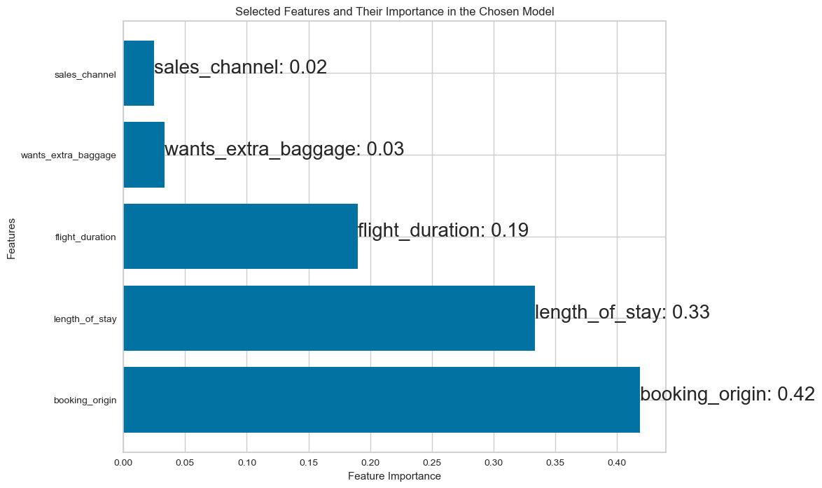
Results of Predictive Modeling Using Random Forest
Model | Accuracy | Precision | Recall | F1-Score
Random Forest Classifier with Oversampling (All Features) | 0.8416 | 0.4313 | 0.2334 | 0.3029
Random Forest Classifier with Oversampling and Top 5 Feature Importance from All Features | 0.8221 | 0.3670 | 0.2852 | 0.3210
Random Forest Classifier with Oversampling and Selected Features | 0.713 | 0.2777 | 0.5886 | 0.3774
Selected Features and Their Importance in the Chosen Model
In the context of predicting booking_complete, we are primarily concerned with achieving the highest Recall value. This is because we want to ensure that we predict as many cases where the customer actually completes the booking (true positives), minimizing the number of cases where the customer actually completes the booking but we fail to predict it (false negatives).
In this case, the model with Oversampling and Selected Features has the highest Recall value (0.5886), meaning this model predicts the most cases where the customer actually completes the booking. Therefore, the third model is deemed the most suitable for this purpose. Despite having lower accuracy, it is important to emphasize that a higher Recall value is more crucial in this context.

